Slide 1
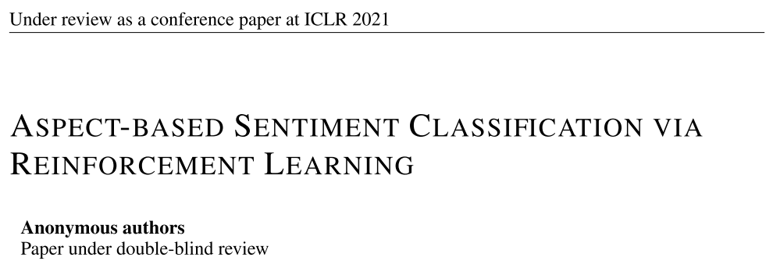
Chongqing University of Technology
ATAI
Advanced Technique of Artificial Intelligence
Chongqing University of Technology
ICLR_2021
Hongyang Song

Slide 2
Outline
Motivation
Approach
Experiments
Conclusion

Slide 3
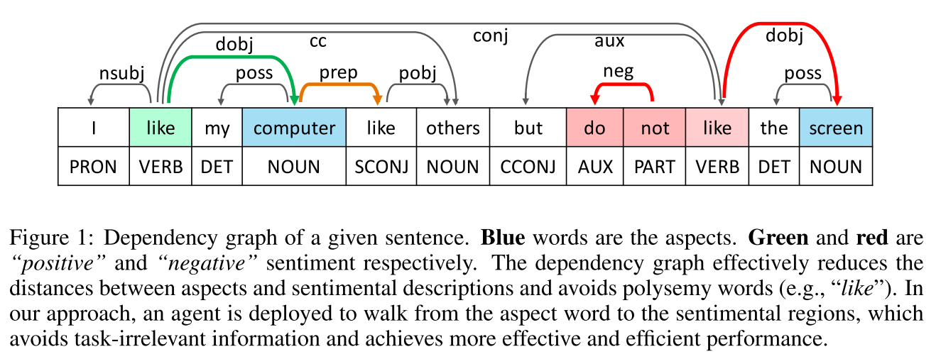
Motivation

Slide 4
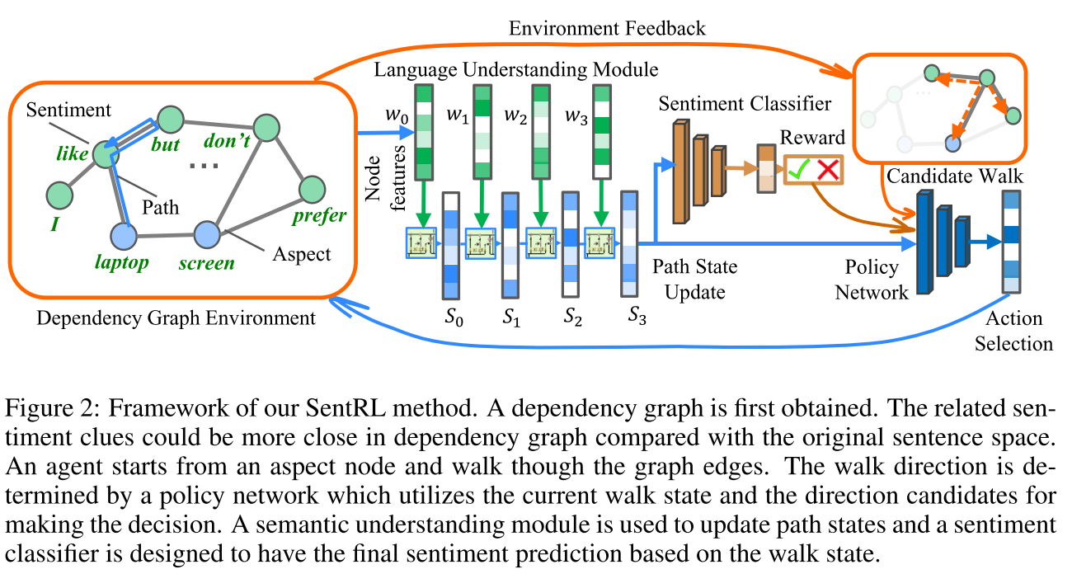
Approach
Notes:
s表示节点多跳的表示，

Slide 5
Gumbel(0,1) distribution
Notes:
从Gumbel(0，1)分布提取的独立同分布样本

Slide 6
Experiments

Slide 7
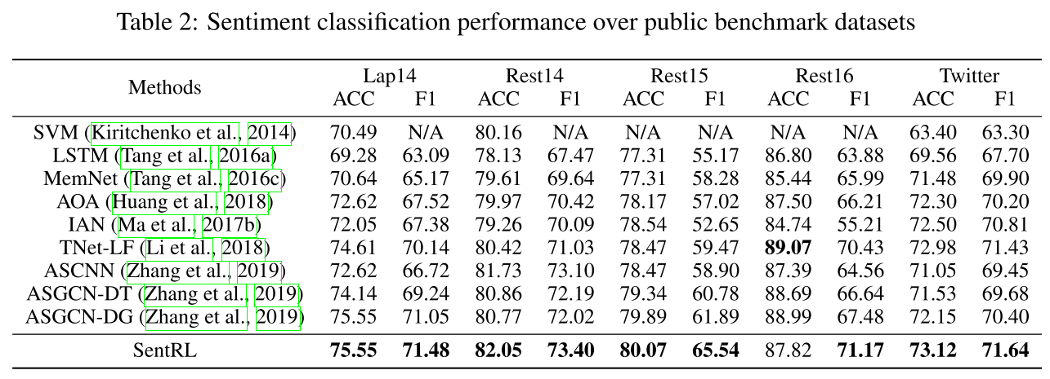
Experiments

Slide 8
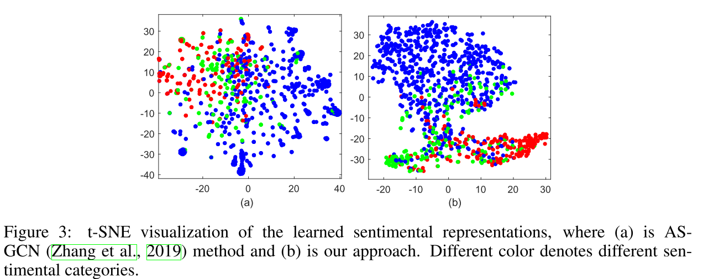
Experiments
t-SNE:
Notes:
红-绿-蓝：消极-中性-积极

Slide 9
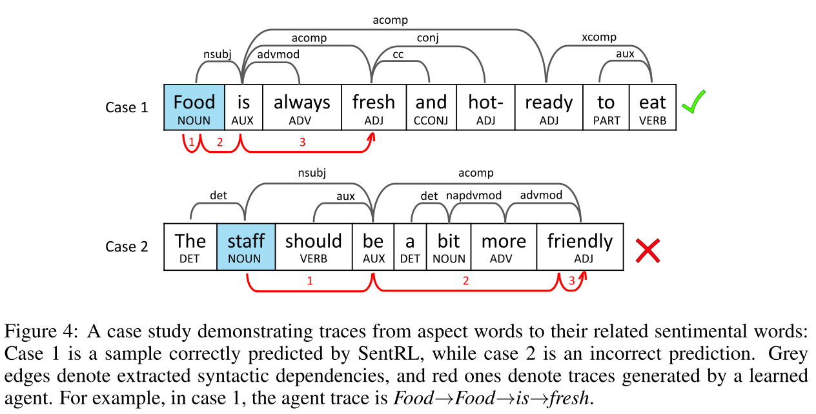
Experiments
Case study:

Slide 10
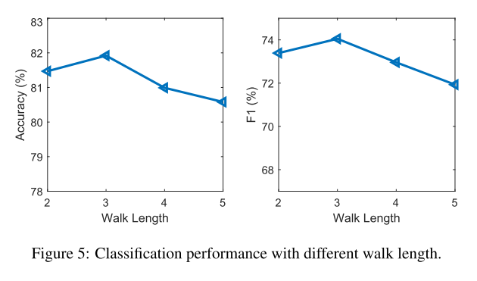
Experiments

Slide 11
Thanks

